Slide 1
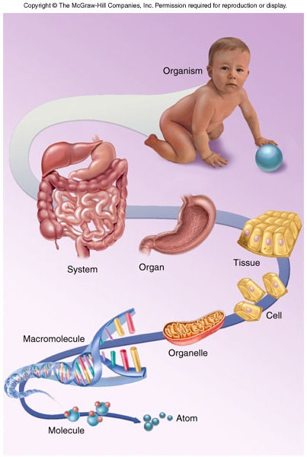
Major Themes of Anatomy and Physiology
Form and Function
Anatomy is the study of what and where
Physiology is the study of how and why

Slide 2
Physiology - The Study of Function
Study of bodily functions
  using methods of experimental science
Comparative physiology
  study of different species
Basis for the development of new drugs and medical procedures

Slide 3
Hierarchy of complexity
organism is composed of organ systems
organ systems composed of organs
organs composed of tissues
tissues composed of cells
Cells contain organelles
Organelles composed of molecules
Molecules composed of atoms

Slide 4
Functional organization of human body
Chemical level- This very basic level and includes atoms, the smallest units of matter that participate in chemical reactions. Certain atoms, such as carbon (C), hydrogen (H), oxygen (O), nitrogen (N), phosphorus (P), calcium (Ca), and sulfur (S), are essential for maintaining life.
Cellular level- Molecules from the atoms combine to form cells, the basic structural and functional units of an organism. Among the many kinds of cells in your body are muscle cells, nerve cells, and epithelial cells.

Slide 5
Tissue level- Tissues are groups of cells and the materials surrounding them work together to perform a particular function. There are just four basic types of tissue in your body: epithelial tissue, connective tissue, muscular tissue, and nervous tissue.
Organ level- organs are structures that are composed of two or more different types of tissues; they have specific functions and usually have recognizable shapes. Examples of organs are the stomach, skin, bones, heart, liver, lungs, and brain.

Slide 6
System level- A system consists of related organs with a common function. An example is the digestive system, which breaks down and absorbs food. Its organs include the mouth, salivary glands, pharynx (throat), esophagus, stomach, small intestine, large intestine, liver, gallbladder, and pancreas.
Organismal level- All the parts of the human body functioning together constitute the total organism.

Slide 7
Tissue
Groups of cells that are similar in structure and perform a common or related function are called tissues.
The four basic types of tissues in the human body contribute to homeostasis by providing diverse functions including protection, support, communication among cells, and resistance to disease.

Slide 8
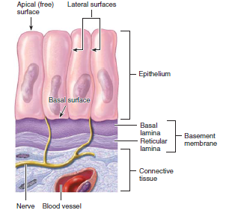
Types of tissue
1. Epithelial tissue covers body surfaces and lines hollow organs, body cavities, and ducts. It also forms glands.

Slide 9
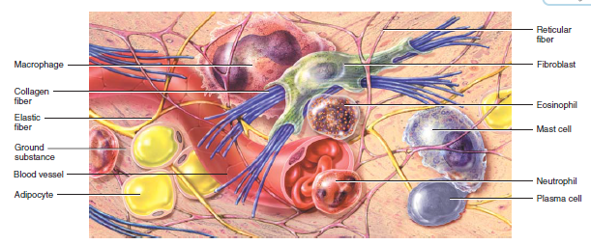
2. Connective tissue protects and supports the body and its organs. Various types of connective tissue bind organs together, store energy reserves as fat, and help provide immunity to disease-causing organisms.

Slide 10
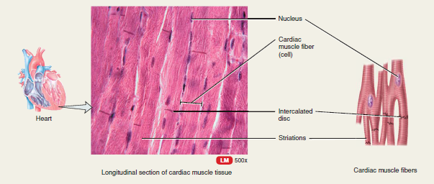
3. Muscular tissue generates the physical force needed to make body structures move and generates body heat.

Slide 11
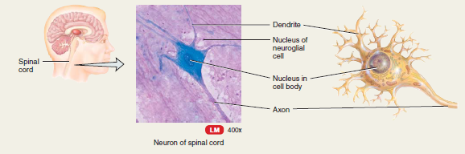
4. Nervous tissue detects changes in a variety of conditions inside and outside the body and responds by generating action potentials (nerve impulses)

Slide 12
Characteristics of Life
Movement – change in position; motion
Responsiveness – reaction to a change
Growth – increase in size
Reproduction – production of new organisms and new cells
Respiration – obtaining oxygen; removing carbon dioxide; releasing energy from foods
1-6

Slide 13
Characteristics of Life
Digestion – breakdown of food substances
Absorption – passage of substances through membranes and into body fluids
Circulation – movement of substances in body fluids
Assimilation – changing of absorbed substances into different substances
Excretion – removal of wastes
1-7

Slide 14
Requirements of Organisms
Water
- most abundant substance in body
- required for metabolic processes
- required for transport
- regulates body temperature
Food
- supply energy
- supply raw materials
1-8

Slide 15
Conti……..
Oxygen
- one-fifth of air
- used to release energy from nutrients
Heat
- form of energy
- partly controls rate of metabolic reactions
Pressure
- atmospheric pressure – important for breathing
- hydrostatic pressure – keeps blood flowing
1-9

Slide 16
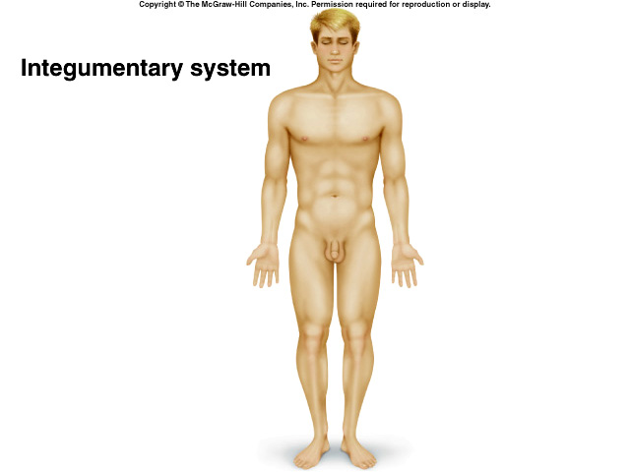
Organ Systems:
Components: Skin and structures associated with it, such as hair, nails, sweat glands,
and oil glands.
Functions: Protects the body; helps regulate body temperature; eliminates
some wastes; helps make vitamin D; and detects sensations such as touch, pain, warmth, and cold.
1-15

Slide 17
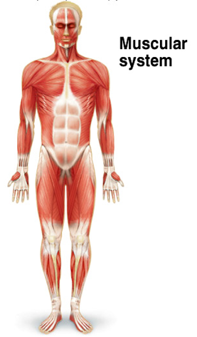
Components:
Muscles composed of skeletal muscle tissue, so-named because it is usually attached to bones.
Functions:
Produces body movements, such as walking; stabilizes body position (posture); generates heat.

Slide 18
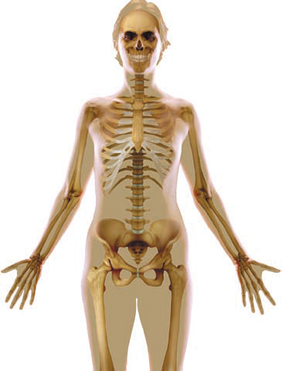
Components:
Bones and joints of the body and their associated cartilages.
Functions:
Supports and protects the body; provides a surface area for muscle attachments; aids
body movements; houses cells that produce blood cells; stores minerals and lipids (fats).

Slide 19
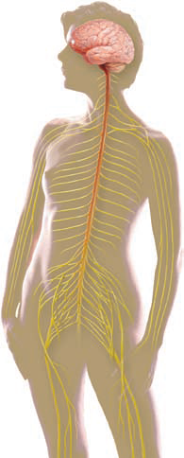
Nervous system
Components:
Brain, spinal cord, nerves, and special sense organs, such as the eyes and ears.
Functions:
Generates action potentials (nerve impulses) to regulate body activities; detects changes
in the body’s internal and external environments, interprets the changes, and responds by causing muscular contractions
or glandular secretions.
1-16

Slide 20
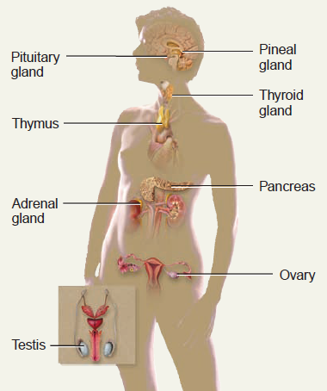
Components:
Hormone-producing glands (pineal gland, hypothalamus, pituitary gland, thymus, thyroid gland, parathyroid glands, adrenal glands, pancreas, ovaries, and testes) and
hormone-producing cells in several
other organs.
Functions: Regulates body activities by
releasing hormones, which are chemical
Messengers transported in blood from an endocrine gland or tissue to a target organ.

Slide 21
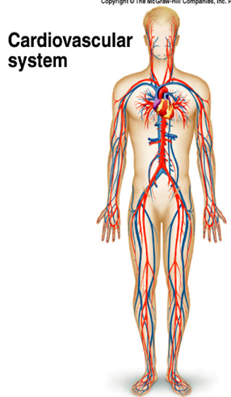
Components:
Blood, heart, and blood vessels.
Functions:
Heart pumps blood through blood vessels; blood carries oxygen and
nutrients to cells and carbon dioxide
and wastes away from cells and helps
regulate acid–base balance, temperature, and water content of body fluids; blood
components help defend against disease and repair damaged blood vessels.

Slide 22
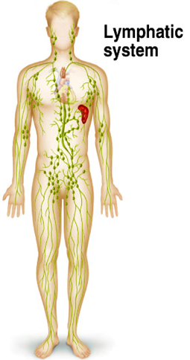
Components:
Lymphatic fluid (lymph) and vessels; also includes spleen, thymus, lymph nodes, and tonsils.
Functions:
Returns proteins and fluid to blood;
carries lipids from gastrointestinal
tract to blood; includes structures
where lymphocytes that protect against disease-causing microbes mature and proliferate.

Slide 23
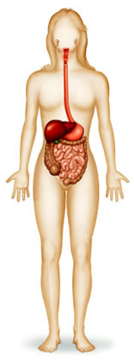
Components:
Organs of gastrointestinal tract, a long tube that includes the mouth, pharynx (throat), esophagus, stomach, small and large intestines, and anus; also includes accessory organs that assist in digestive processes, such as the salivary glands, liver, gallbladder, and pancreas.
Functions:
Achieves physical and chemical breakdown of food; absorbs nutrients; eliminates solid wastes.
1-17

Slide 24
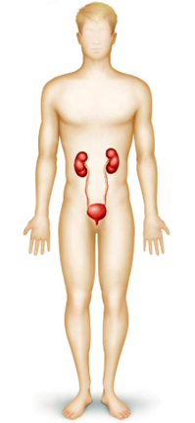
Components:
Kidneys, ureters, urinary bladder, and urethra.
Functions:
Produces, stores, and eliminates urine; eliminates wastes and regulates volume and chemical composition of blood; helps maintain the acid–base balance of body fluids; maintains body’s mineral balance; helps regulate production of red blood cells.
1-17

Slide 25
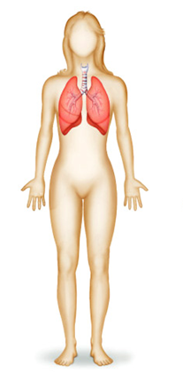
Components:
Lungs and air passage ways such as the pharynx (throat), larynx (voice box), trachea (windpipe), and bronchial tubes leading into and out of the lungs.
Functions:
Transfers oxygen from inhaled air to blood and carbon dioxide from blood to exhaled air; helps regulate acid–base balance of body fluids; air flowing out of lungs through vocal cords produces sounds.
1-17

Slide 26
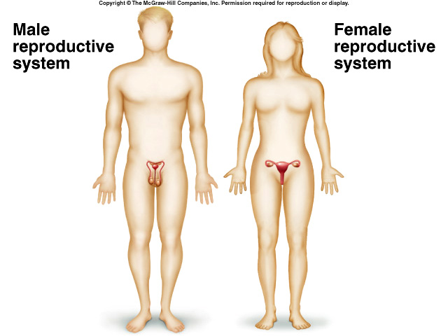
Components:
Gonads (testes in males and ovaries in females) and associated organs (uterine tubes, uterus, and vagina in females and
epididymis, ductus deferens, and
penis in males).
Functions:
Gonads produce gametes (sperm or oocytes) that unite to form a new organism; gonads also release hormones
that regulate reproduction and other body processes; associated organs transport

Slide 27
Homeostasis
Body’s maintenance of a stable internal environment
Homeostatic Mechanisms – monitor aspects of the internal environment and corrects any changes
  Receptors - provide information
  Control center - tells what a particular value should be
  Effectors - causes responses to change internal environment
1-10

Slide 28
Mechanisms we use to maintain life
Negative feedback
Positive feedback
Feed forward or anticipatory feedback
These cycles are in constant motion
When we loose control we encounter
dis-ease and even death

Slide 29
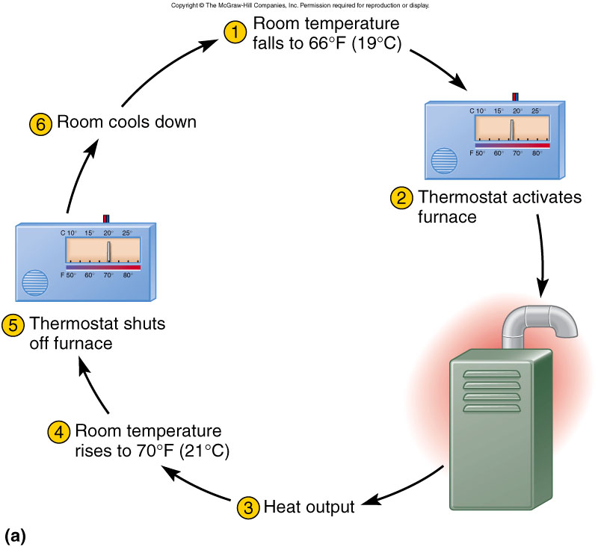
Negative Feedback Loop
Body senses a change and activates mechanisms to reverse it

Slide 30
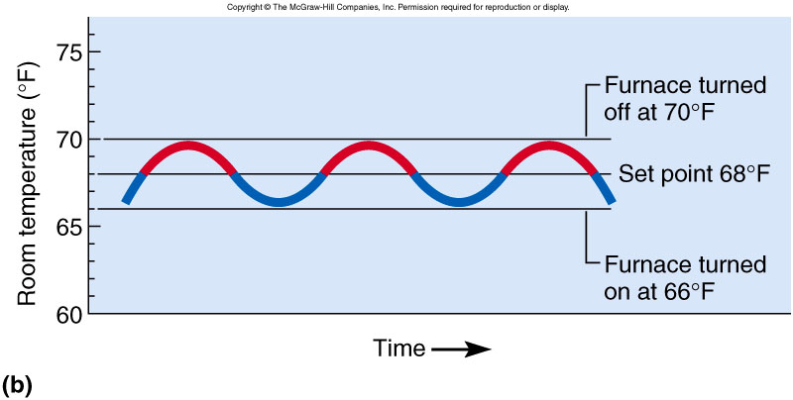
Negative Feedback, Set Point
Room temperature does not stay at set point of 68 degrees -- it only averages 68 degrees

Slide 31
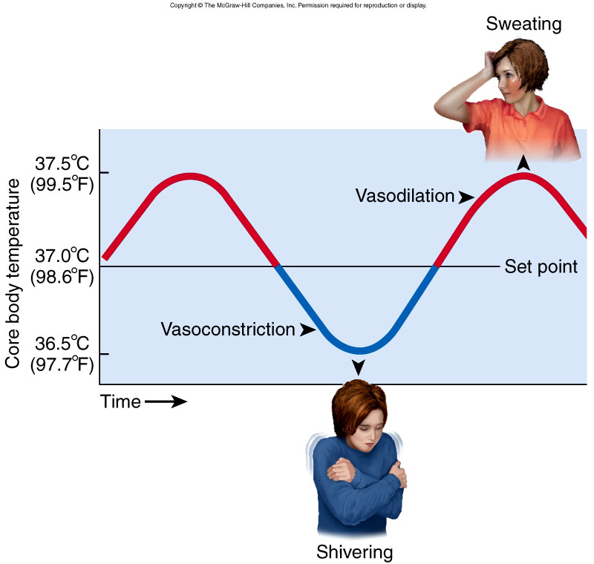
Human Thermoregulation
Brain senses change in blood temperature
  if overheating, vessels dilate in the skin and sweating begins
  if too cold, vasoconstriction in the skin and shivering begins

Slide 32
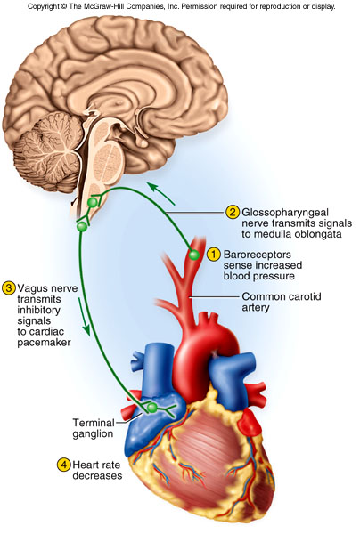
Control of Blood Pressure
Circulatory stretch receptors
  detect a rise in BP
Cardiac center in brainstem
  sends out nerve signals
Heart slowed and BP lowered

Slide 33
Structure of Feedback Loop
Receptor = senses change
Integrator = control center that responds
Effector = structures that restore homeostasis

Slide 34
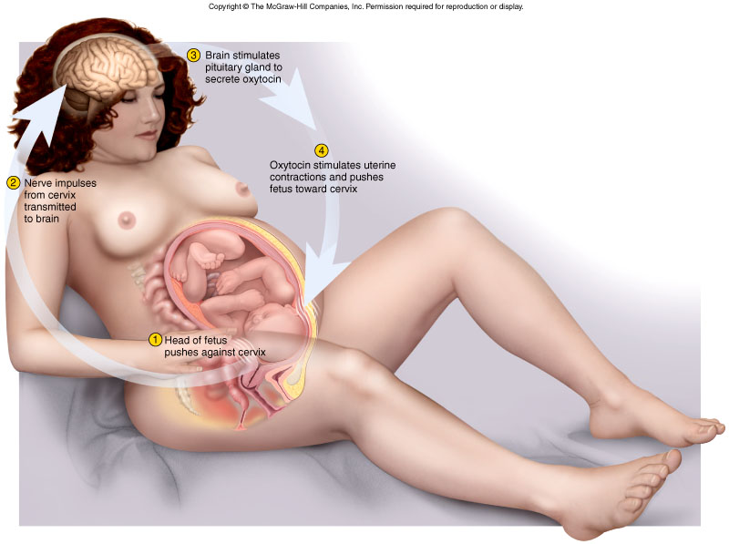
Positive Feedback Loops
Self-amplifying change
  leads to change in the same direction
Normal way of producing rapid changes
  occurs with childbirth, blood clotting, protein digestion, and generation of nerve signals

Slide 35
Life-Threatening Fever
Temperature > 108 degrees F
  increases metabolic rate
  body produces heat even faster
Cycle continues to reinforce itself
Becomes fatal at 113 degrees F

